Slide 1

DDS Analytics
Talent management

Slide 2
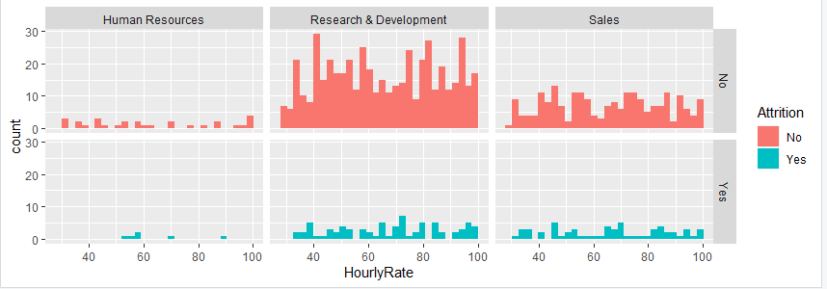
Attrition
This can be defined as a process in which the workforce dwindles at a company, following a period in which several people retire or resign and are not replaced.
-Dictionary definition.

Slide 3
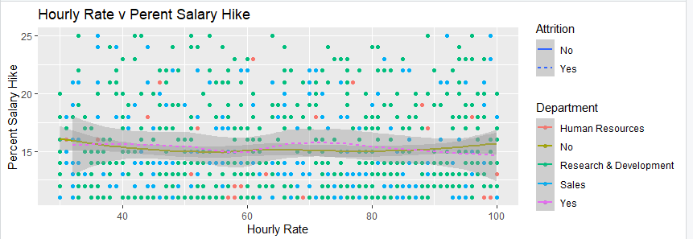
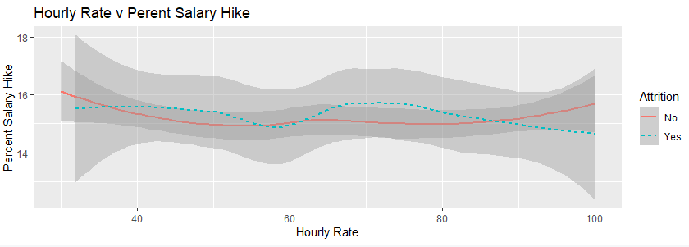
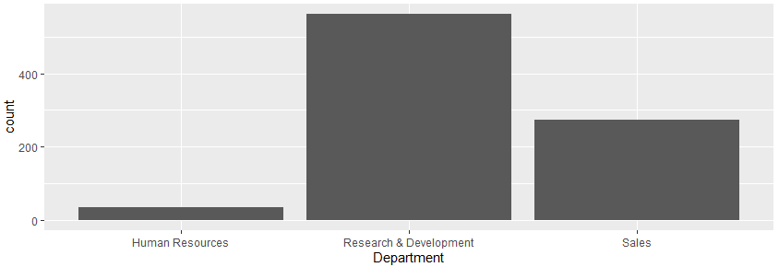
Comparing rates
Percent salary hike

Slide 4
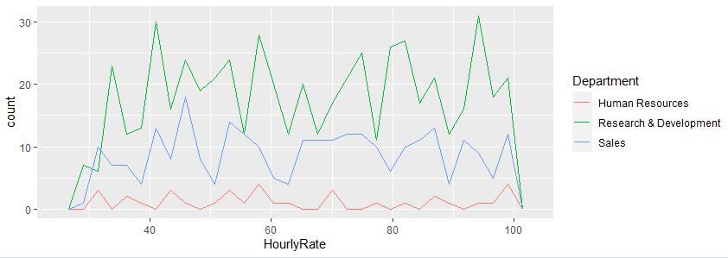
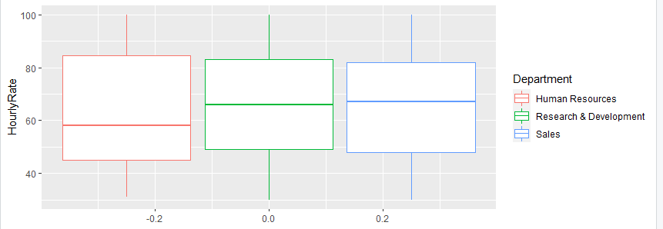
Box plots

Slide 5
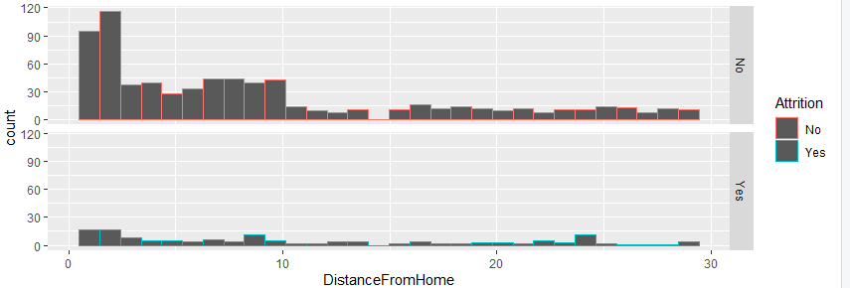
Attrition as a result of distance from home

